Slide 1
Xchedule
Rex J. Reyes
Gabriel Rosario
Carlos Ayala
Yetsiel Áviles

Slide 2
Introduction
Business
Services
Scheduling
Xchedule
Organization
Effectiveness
Visualization

Slide 3
Problem Statement
Businesses do not possess an efficient way of managing appointments without having to interact with each individual request. Furthermore, some businesses do not even have an effective way of organizing their schedule.

Slide 4
Scope
Business oriented scheduling management.

Slide 5
Objectives
Provide a scheduler to those businesses that do not possess a way of organizing their appointments.
Enable the client to schedule an appointment with the fewest business interaction possible.
Present all appointments, to either a client or business, in the same place.

Slide 6
Solution
Develop a web application that meets with the projects objectives.
There exist similar solutions, but none that closes the gap Xchedule does.
This solution could be commercialized through:
Ads
Premium Account

Slide 7
Market Analysis
The market domain includes everyone that owns a business which benefits from having a schedule, and anyone that typically attends these businesses.
Possible competitors could be applications such as:
Google Calendar
Trello

Slide 8
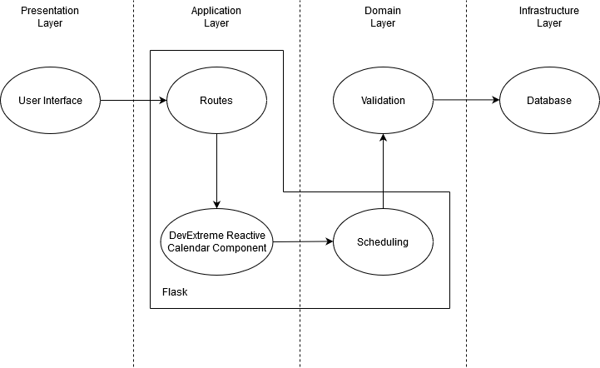
Technical Description
System Architecture
Frontend
ReactJS
Axios
Backend
Python Flask
PostgreSQL

Slide 9
Future Work
Project properly documented so other developers can catch up quickly.
Features that can be implemented during future work:
Ads so different businesses can be sponsored.
Creating a mobile app application based on the created web application.
Notification settings.
File handling within the application.

Slide 10
Conclusion
Xchedule improves both the clients and businesses schedule organization.
Xchedule allows clients to schedule themselves without the business interacting.
The application is simple and easy to use for all different kinds of users

